Slide 1
Welcome to COMP 157!
Prof. Hayes

Slide 2
Contact Info
Office Hours: MWF 10-11, 3:30-4:30 or by appt
Office: CTC 125
Email: ehayes@pacific.edu
Site: canvas.pacific.edu
Grades / Assignments posted here

Slide 3
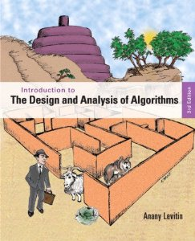
Textbook
Readings for each class
HW Exercises
Reference for Projects

Slide 4
Grading
Labs in Pairs, HWs Individual
Academic Honesty is critical
My Goal: See You Master the Material!
Item | Percentage
Labs | 20%
HWs | 35%
Midterms | 25%
Final | 20%
A | A- | B+ | B | B- | C+ | C | C- | D
93 | 90 | 87 | 83 | 80 | 77 | 73 | 70 | 60

Slide 5
Pre-Requisites
Object-Oriented Programming
Iteration & Recursion
Data Structures
Simple Searching & Sorting Algorithms
Basic Big O Notation
Discrete Mathematics
Derivatives & Limits

Slide 6

Programming Language
Who already has experience coding in Python?

Slide 7
Course Map
Recognize common problem types in computer science and apply standard algorithms to solve them.
Fundamentals
Brute Force
Maze Project
Decrease & Conquer
HW 2
Mock Interview Labs
Divide & Conquer
Design algorithms for a new problem using a toolkit of design approaches, both optimal and approximate.
Transform & Conquer
Fuzzy Search Project
Confidently approach algorithms questions in job interviews.
Space-Time Tradeoffs
HW 3
Dynamic Programming
HW 4
Consider multiple approaches to solve a specific problem and evaluate the time and space requirements of each approach.
Greedy Algorithms
Compression Project
Convey algorithmic ideas in pseudocode and translate pseudocode into a working implementation.
Iterative Improvement
Limitations
Labs & HWs
Data Structures
Mathematical Analysis of Algs
Overcoming Limitations
HW 5
Labs
HW 1

Slide 8
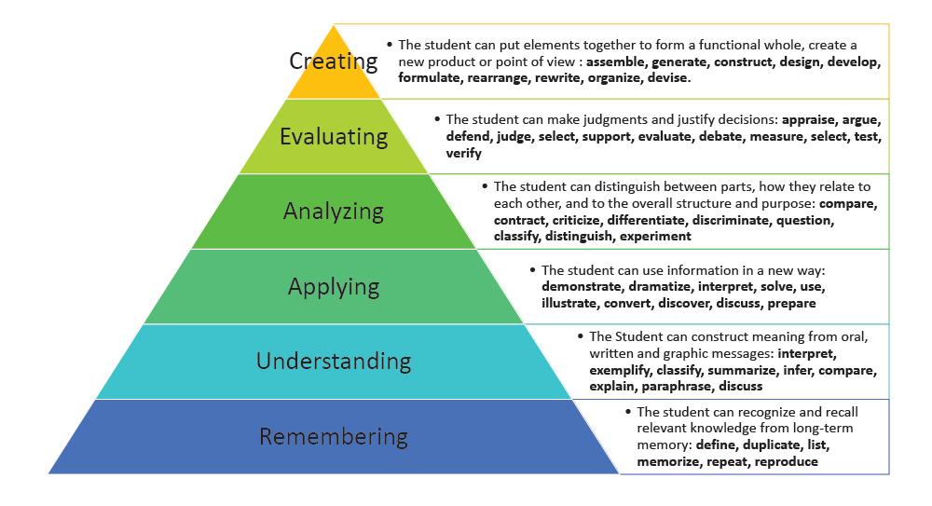
How We Learn?
By Failing!!
Growth Mindset
Predict/Wrestle First – Then Answer – Self Test
Notes – Rephrase & Integrate – Writing
Use
Spaced Repetition
Not Multi-Tasking

Slide 9
Algorithms

Slide 10






Most Important Class?

Slide 11
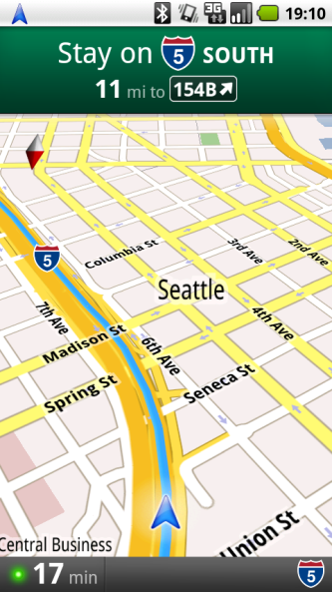

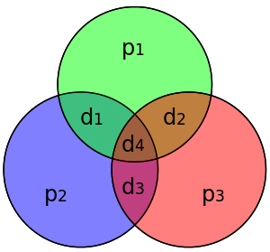


Why Study Algorithms?
To get a job! ☺
To write better code!
To be a computer scientist!
To improve at critical thinking!
To change the world!
To win ICPC!
To be cool??

Slide 12
What Is An Algorithm?
“An algorithm is a sequence of unambiguous instructions for solving a problem, i.e., for obtaining a required output for any legitimate input in a finite amount of time.”
An algorithm is “not an answer but specific instructions for getting an answer” to a problem.

Slide 13
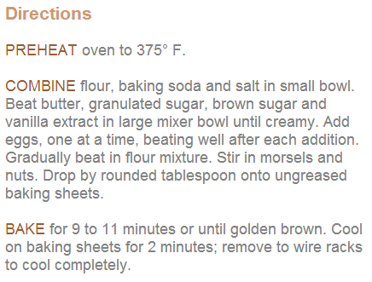
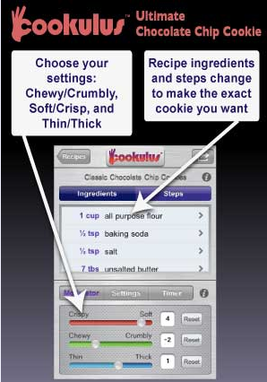
What Is An Algorithm?
“An algorithm is a sequence of unambiguous instructions for solving a problem, i.e., for obtaining a required output for any legitimate input in a finite amount of time.”

Slide 14
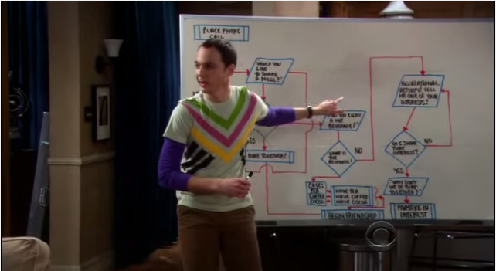
What Is An Algorithm?
“An algorithm is a sequence of unambiguous instructions for solving a problem, i.e., for obtaining a required output for any legitimate input in a finite amount of time.”

Slide 15
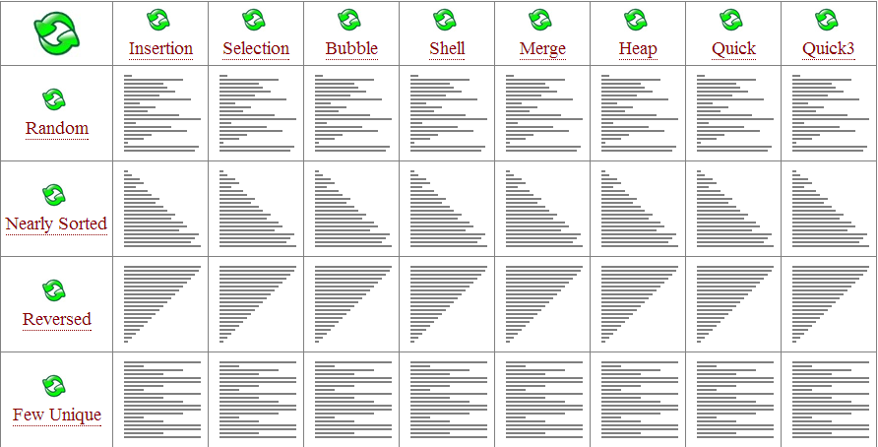
Multiple Algs for Same Problem
May solve the problem with dramatically different speeds.

Slide 16
Reading for Next Class
No reading, but following are useful references:
https://docs.python.org/3/tutorial/index.html
https://docs.python.org/3/reference/index.html
http://www.tutorialspoint.com/python/
Install Python 3 on your laptop
Optional: PyCharm IDE

